Slide 1

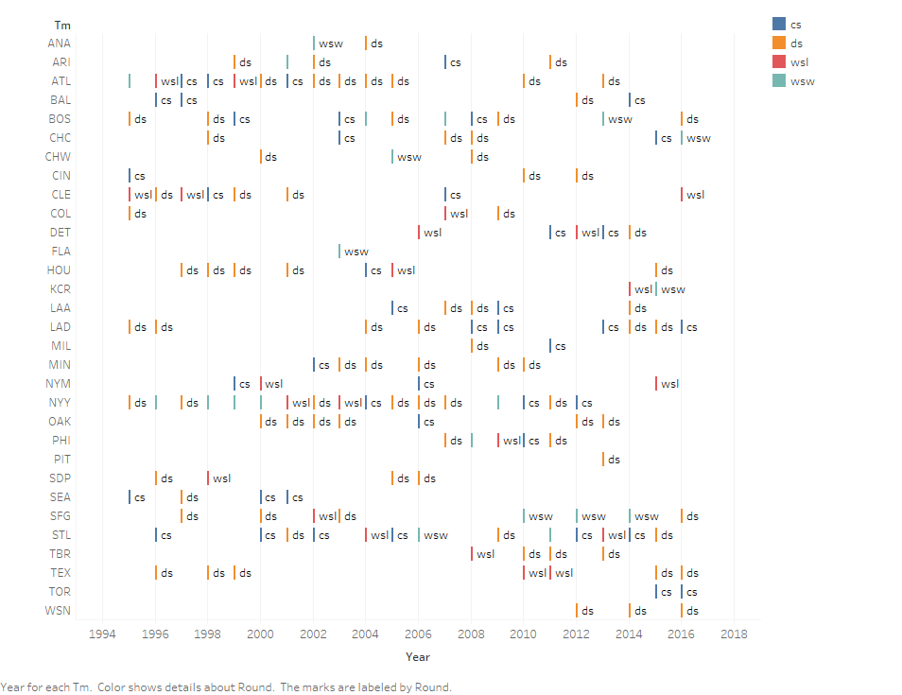
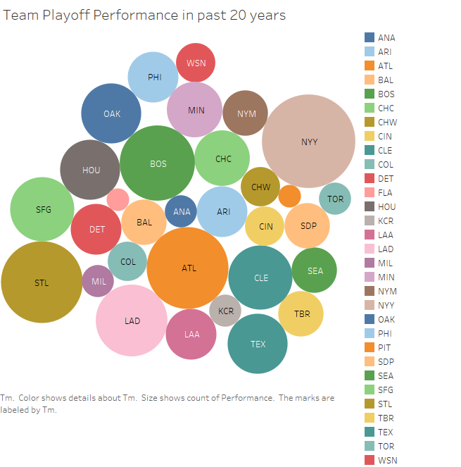
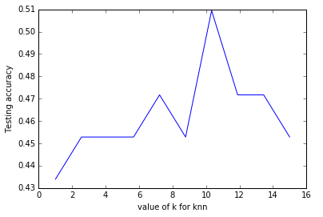
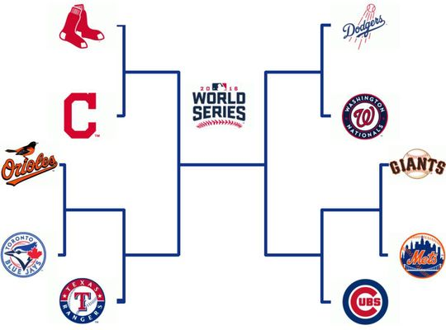
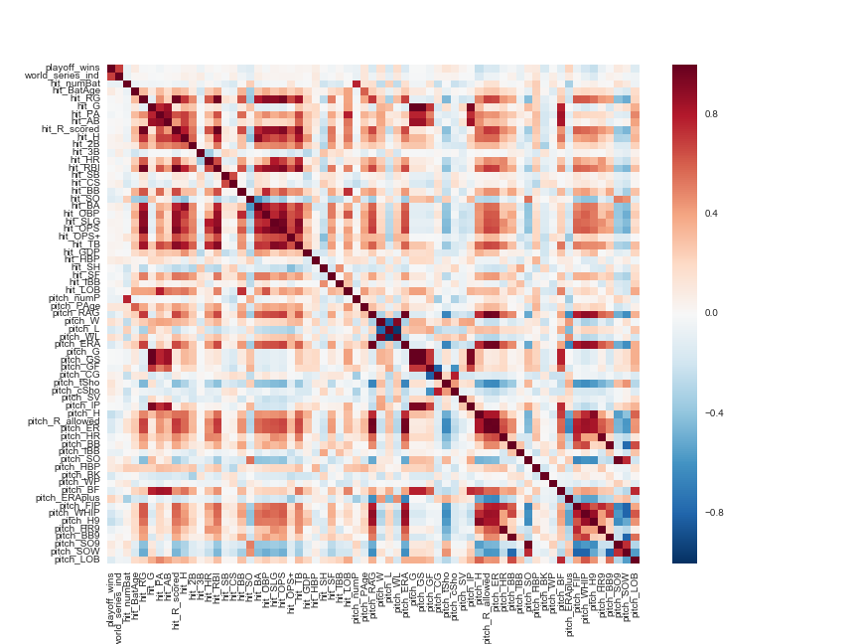
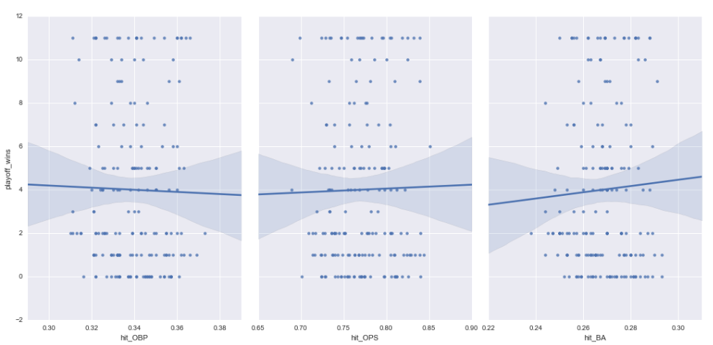


MLB World Series Performance Model
Team Members:
Deepti Aggarwal, Matan Becker, Michael Costner,
Rohan Singla, Mehdi Mahmoodi
Final Model
Goal
Earlier before applying any feature
Selection algorithm the accuracy for
All the features via KNN was 43% and for
Logistic Regression it was 47%.After Applying Feature
Selection Algorithm it as improved till 51%
Data Exploration
Algorithms
Determine which round each team will reach
Model | Features | Accuracy | Recall | Precision | F1-Score
KNN | OBP, OPS, SLG, BA, WHIP | 50.94 % | 29.72% | 21.96% | 24.79%
Logistic | OBP, OPS, SLG, BA, WHIP | 50.94% | 25% | 12.73% | 16.87%
Top -3 Teams-
(Over 20 years)
NY Yankees
ATL Braves
STL Cardinals
Model | Feature | Accuracy | Precision
KNN with k-cross validation | OBP, OPS, SLG, BA, WHIP | 51.03 % | 15.26%
Logistic regression with k-cross validation | OBP, OPS, SLG, BA, WHIP | 50.413% | 12.603%
KNN
Graph shows that for k=10,
KNN will give highest accuracy
Predicted 2016 World Series Winner
Data
Linear
Statistics improve as teams advance in playoffs
Team statistics from 162 regular season games
Pitching and hitting statistics
Gathered from 1995 – 2016
60+ statistics gathered →
Batting average, homeruns, strikeouts, wins, hits, on base percentage, ERA…
The accuracy was only 10%
Precision – 22%
Therefore we ignored this model
Feature Selection
Methods | Features
Recursive Feature Elimination (RFE) | OBP, OPS, SLG, BA, WHIP
ExtraTrees Classifier | Pitch_H,hit_BB,hit_HR,hit_H,hit_2B)
Random Forest Regressor | hit_BB,hit_2B,pitch_H,pitch_WP,pitch_SV
Correlation matrix
Tools & References
Seaborn
Matplotlib
Py4j
Pyspark
Atexit
Train_test_split
www.baseball-reference.com

